Slide 1
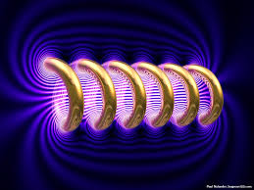
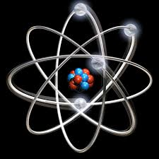

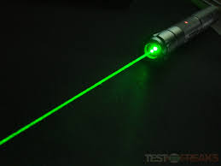


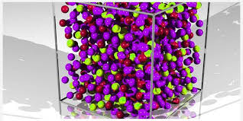
Engineering Physics
PHY-109
Solid State Physics-2
ELECTROMAGNETIC THEORY
QUANTUM MECHANICS
LASER
WAVES
Dr. Jeeban Pd Gewali
Department of Physics
Lovely Professional University
Phagwara, Punjab-144411
SOLID STATE PHYSICS
FIBER OPTICS

Slide 2
Syllabus
Free electron theory (Introduction).
Diffusion and drift current (qualitative).
Fermi energy, Fermi-Dirac distribution function.
Band theory of solids - formation of allowed and forbidden energy bands.
Semiconductors and insulators, Fermi level for intrinsic and extrinsic semiconductors.
Direct and indirect band gap semiconductors.
Concept of effective mass - electrons and holes.
Hall effect (with derivation).

Slide 3
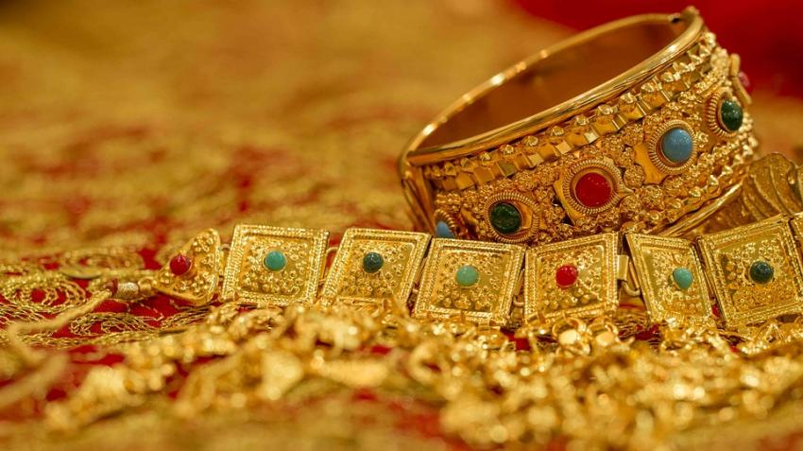
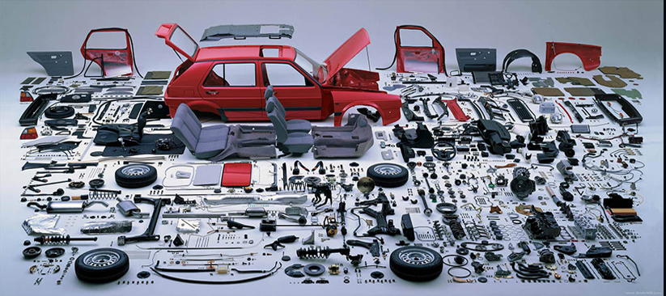

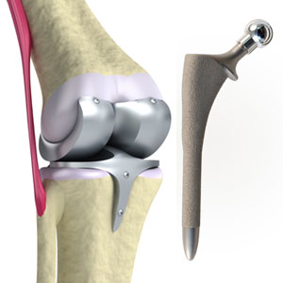

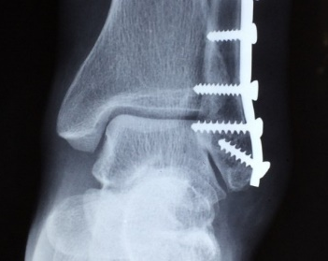
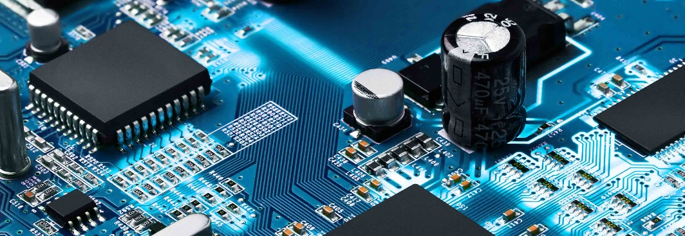
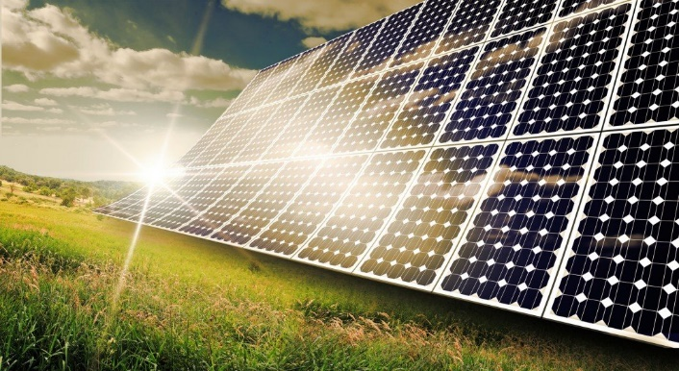
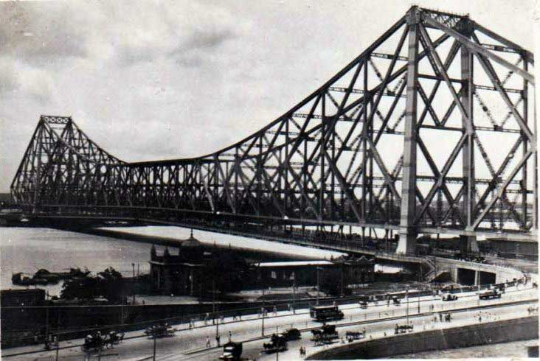
Solid
Metals:
Na, Fe, Cu, Al, Au, Ag, Ti, Ni, Pt etc.
Semiconductor/Insulators:
Si, Ge, GaAs, BN, Al₂O₃, ZnO, TiO₂, SiO₂, CdTe, PbS, ZnS etc.

Slide 4
Metals
The simplest metals are the alkali metals with one valence electrons such as Na, K, Li etc.
The electronic configuration of sodium is Na- 1s² 2s² 2p⁶ 3s¹.
The last electron behaves as a conduction electrons in metal which is also called the free electron.
The free electron behaves like the molecules in a perfect gas and are called free electron gas.
The free electron theory considers the force between the conduction electrons and the ion cores are neglected so that the total energy of the electron is all kinetic and the potential energy is taken to be zero. Therefore the motion of the electrons within the metal is free because there are no collisions, similar to the molecules of an ideal gas.
It was believed that many physical properties of metals including electrical and thermal conductivities can be understood by considering free electron model. The works of Lorentz and Drude are important to cite here.
Free electron theory https://www.youtube.com/watch?v=ttdtdLfn9HU

Slide 5
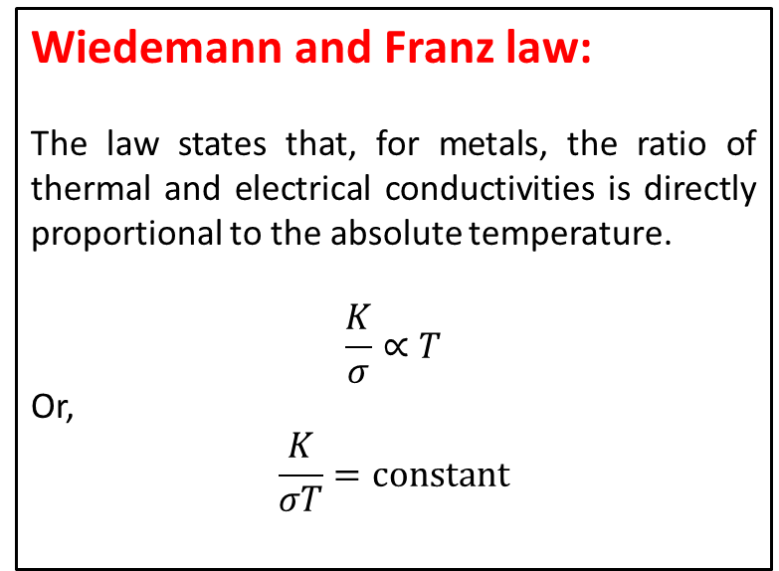
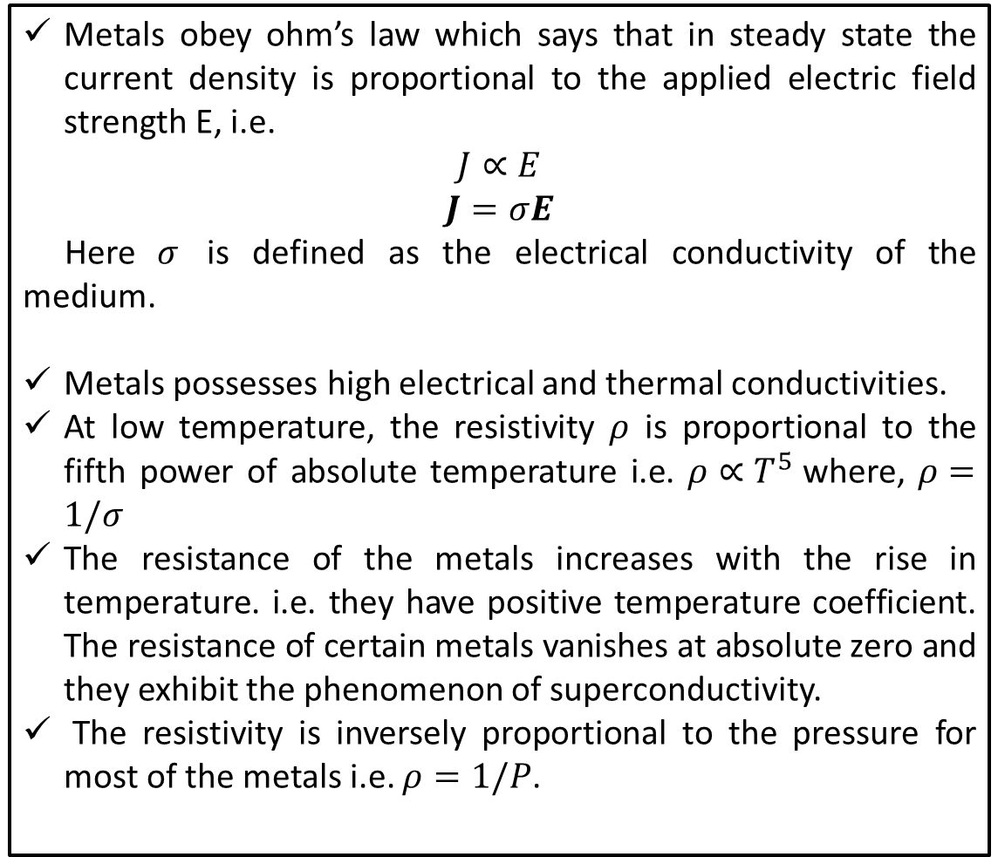
Properties of Metals
Metals obey ohm’s law which says that in steady state the current density is proportional to the applied electric field strength E, i.e.
$$J∝E$$
$$J=σE$$
Here $σ$ is defined as the electrical conductivity of the medium.
Metals possesses high electrical and thermal conductivities.
At low temperature, the resistivity $ρ$ is proportional to the fifth power of absolute temperature i.e. $ρ∝T^{5}$where, $ρ=1/σ$
The resistance of the metals increases with the rise in temperature. i.e. they have positive temperature coefficient. The resistance of certain metals vanishes at absolute zero and they exhibit the phenomenon of superconductivity.
The resistivity is inversely proportional to the pressure for most of the metals i.e. $ρ=1/P$.
Wiedemann and Franz law:
The law states that, for metals, the ratio of thermal and electrical conductivities is directly proportional to the absolute temperature.
$$\frac{K}{σ}∝T$$
Or,
$$\frac{K}{σT}=constant$$

Slide 6
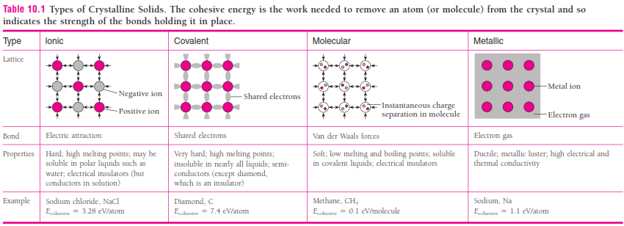
Comparison of bonds

Slide 7
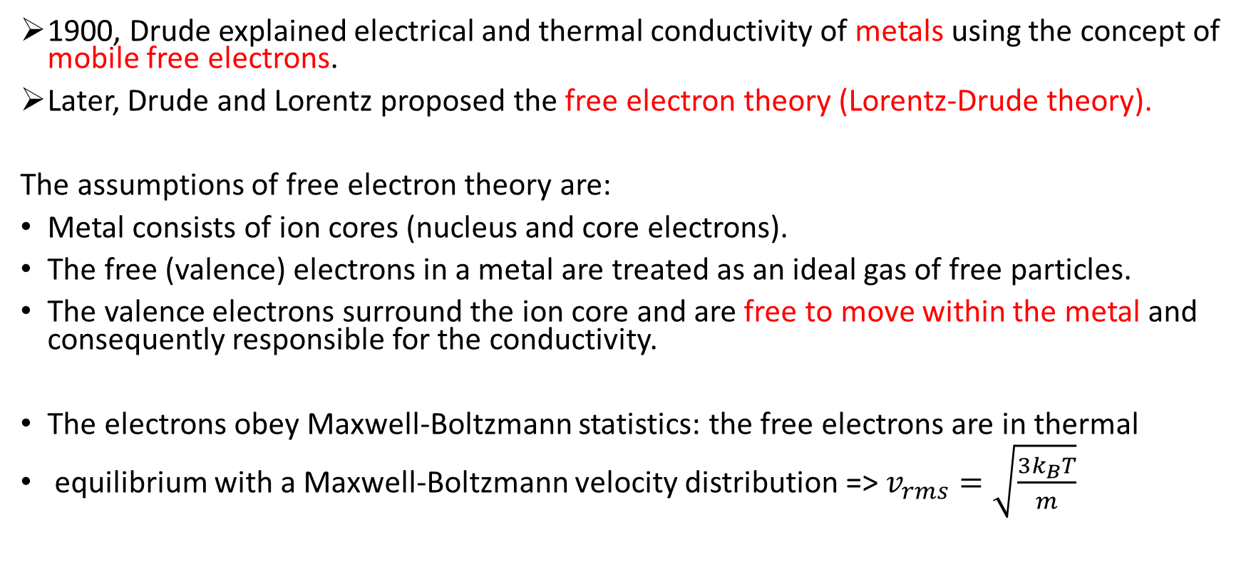
Classical Picture and Lorentz-Drude Model
1900, Drude explained electrical and thermal conductivity of metals using the concept of mobile free electrons.
Later, Drude and Lorentz proposed the free electron theory (Lorentz-Drude theory).
The assumptions of free electron theory are:
Metal consists of ion cores (nucleus and core electrons).
The free (valence) electrons in a metal are treated as an ideal gas of free particles.
The valence electrons surround the ion core and are free to move within the metaland consequently responsible for the conductivity.
The electrons obey Maxwell-Boltzmann statistics: the free electrons are in thermal
equilibrium with a Maxwell-Boltzmann velocity distribution =>$v_{rms}=\sqrt{\frac{3k_{B}T}{m}}$
Maxwell boltzmann statistics
https://www.youtube.com/watch?v=xQ9D4Jz95-A

Slide 8
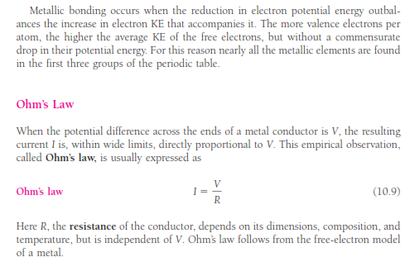
Ohm’s Law

Slide 9
Classical Picture and Lorentz-Drude Model
We begin by assuming that
the free electrons in a metal, like the molecules in a gas, move in random directions and undergo frequent collisions.
These collisions are not billiard-ball collisions with other electrons but represent the scattering of Electron waves by irregularities in the crystal structure, both defects such as impurity atoms and also atoms temporarily out of place as they vibrate.
As we will see later, the Atoms of a perfect crystal lattice do not scatter free Electron waves except under certain specific circumstances.

Slide 10

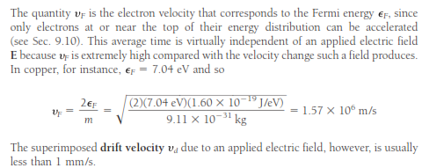
Electrical Properties of Metals
If λ is the mean free path between the collisions of a free electron, the average time between collisions is

Slide 11

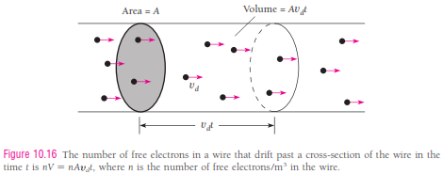
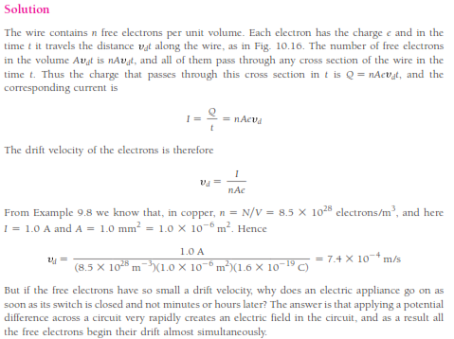
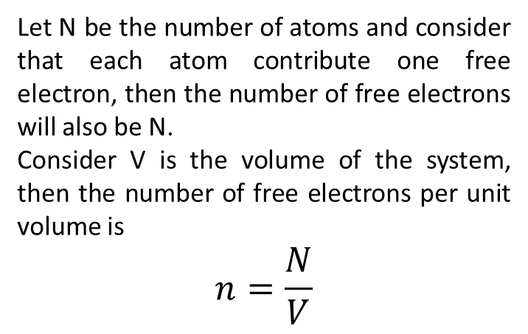
Let N be the number of atoms and consider that each atom contribute one free electron, then the number of free electrons will also be N.
Consider V is the volume of the system, then the number of free electrons per unit volume is
$$n=\frac{N}{V}$$
Drift velocity
https://www.youtube.com/watch?v=qg0JY4GNK0w

Slide 12

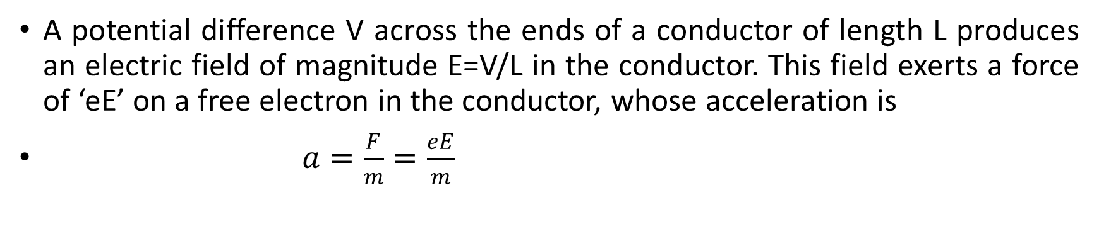
Electrical Properties of Metals
A potential difference V across the ends of a conductor of length L produces an electric field of magnitude E=V/L in the conductor. This field exerts a force of ‘eE’ on a free electron in the conductor, whose acceleration is
$a=\frac{F}{m}=\frac{eE}{m}$
An electric field produces a general drift superimposed on the random motion of a free electron. The electron’s path between collisions is actually slightly curved because of the acceleration due to the field.
When the electron undergoes a collision, it bounce back in an arbitrary direction and on the average, no longer has a component of velocity parallel to E. Imposing the field E on the free electron gas in a metal superimposes a general drift on the faster but random motions of the electron. We can therefore ignore the electron’s motion at the Fermi velocity in calculating the drift velocity v_{d}.

Slide 13
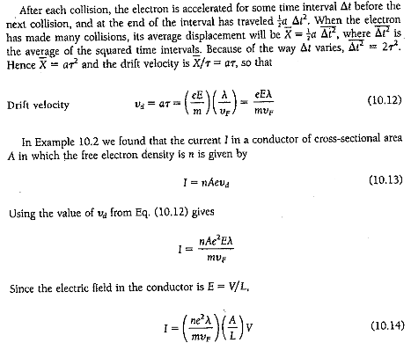
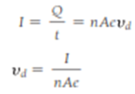

Electrical Properties of Metals
$a=\frac{F}{m}=\frac{eE}{m}$

Slide 14
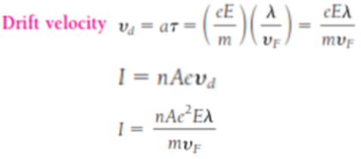
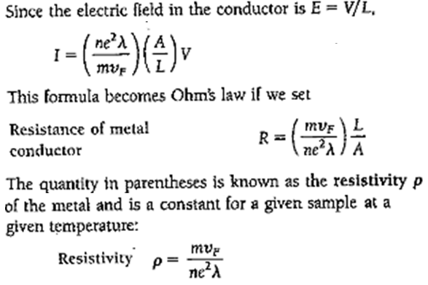
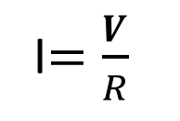
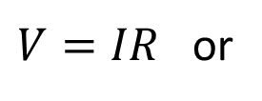
Electrical Properties of Metals
$V=IR$ or
I$=\frac{V}{R}$

Slide 15
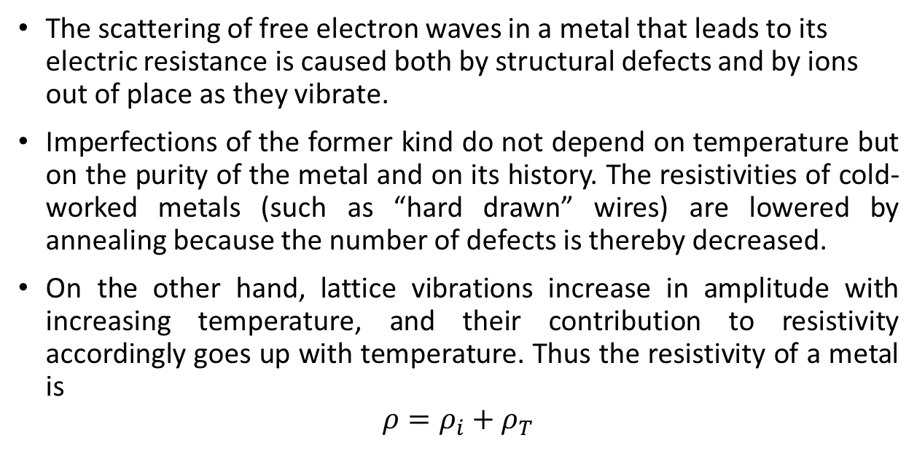
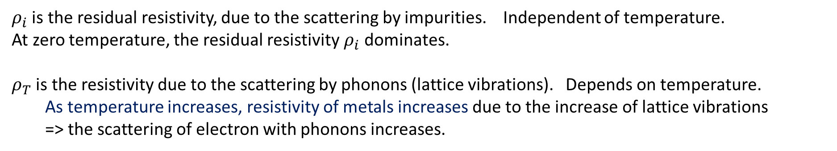
Electrical Properties of Metals: Resistivity
The scattering of free electron waves in a metal that leads to its electric resistance is caused both by structural defects and by ions out of place as they vibrate.
Imperfections of the former kind do not depend on temperature but on the purity of the metal and on its history. The resistivities of cold-worked metals (such as “hard drawn” wires) are lowered by annealing because the number of defects is thereby decreased.
On the other hand, lattice vibrations increase in amplitude with increasing temperature, and their contribution to resistivity accordingly goes up with temperature. Thus the resistivity of a metal is
$$ρ=ρ_{i}+ρ_{T}$$
$ρ_{i}$ is the residual resistivity, due to the scattering by impurities. Independent of temperature.
At zero temperature, the residual resistivity $ρ_{i}$ dominates.
$ρ_{T}$ is the resistivity due to the scattering by phonons (lattice vibrations). Depends on temperature.
As temperature increases, resistivity of metals increases due to the increase of lattice vibrations
=>the scattering of electron with phonons increases.

Slide 16
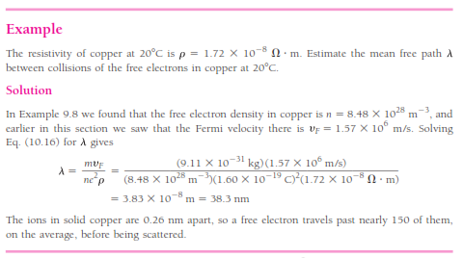
𝑛=𝑁/𝑉

Slide 17
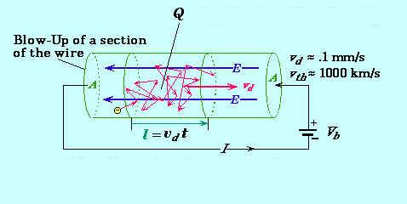
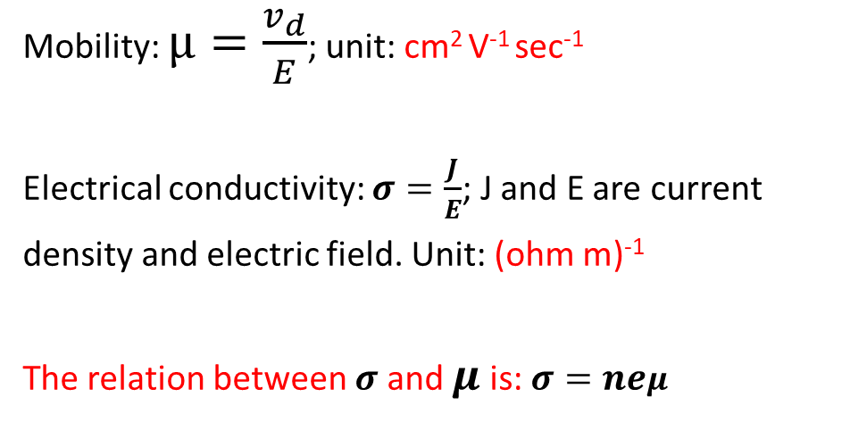
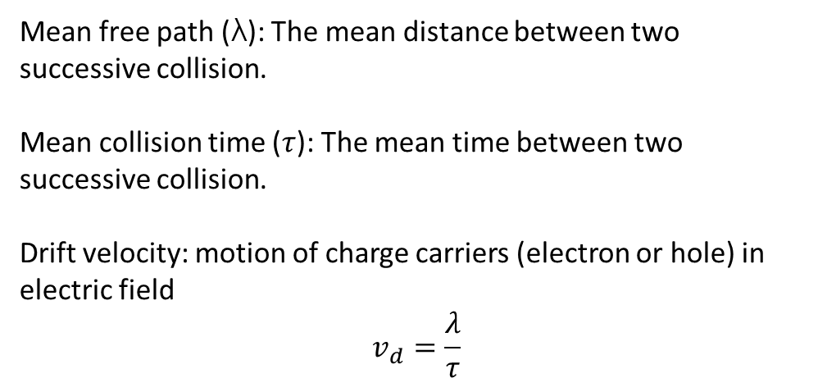
Electrical Properties of Metals
Mean free path (λ): The mean distance between two successive collision.
Mean collision time ($τ$): The mean time between two successive collision.
Drift velocity: motion of charge carriers (electron or hole) in electric field
$$v_{d}=\frac{λ}{τ}$$
Mobility: $μ=\frac{v_{d}}{E}$; unit: cm² V⁻¹ sec⁻¹
Electrical conductivity: $σ=\frac{J}{E}$; J and E are current
density and electric field. Unit: (ohm m)⁻¹
The relation between $σ$ and $μ$ is: $σ=neμ$
Electron mobility is the measure of how fast an electron can move through a metal or semiconductor under the influence of external electric field.
Mobility μ is defined as the magnitude of drift velocity per unit electric field. μ=E∣vd∣.

Slide 18
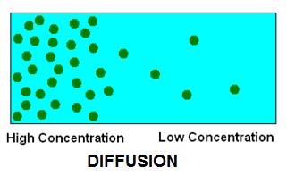
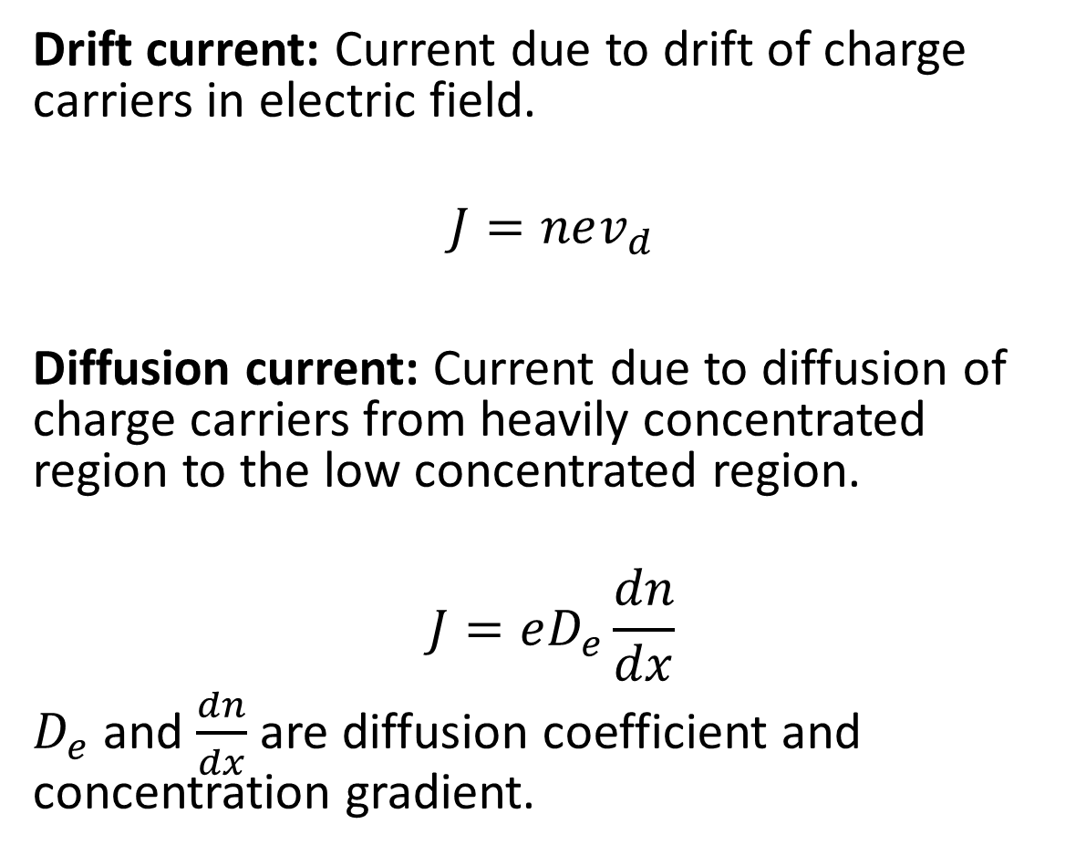
Electrical Properties of Metals
Drift
Drift current: Current due to drift of charge carriers in electric field.
$$J=nev_{d}$$
Diffusion current:Current due to diffusion of charge carriers from heavily concentrated region to the low concentrated region.
$$J=eD_{e}\frac{dn}{dx}$$
$D_{e}$ and $\frac{dn}{dx}$ are diffusion coefficient and concentration gradient.

Slide 19
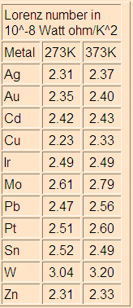
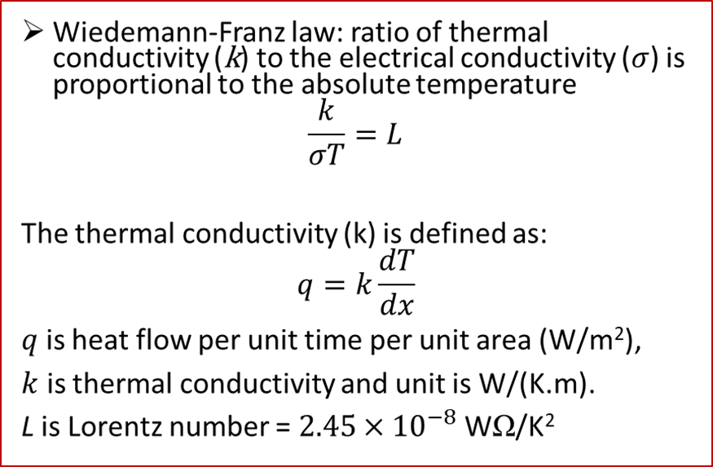
Wiedemann-Franz Law (1853)
(Ludwig) Lorenz Number
(derived via quantum mechanical treatment)
N/V
×10²² /cm³
k_{F}
×10⁸ /cm
v_{F}
×10⁸ cm/s
ε_{F}
eV
T_{F}
×10⁴ K
Li | 4.70 | 1.11 | 1.29 | 4.72 | 5.48
Na | 2.65 | 0.92 | 1.07 | 3.23 | 3.75
Cu | 8.45 | 1.36 | 1.57 | 7.00 | 8.12
Au | 5.90 | 1.20 | 1.39 | 5.51 | 6.39
Be | 24.20 | 1.93 | 2.23 | 14.14 | 16.41
Al | 18.06 | 1.75 | 2.02 | 11.63 | 13.49
Pb | 13.20 | 1.57 | 1.82 | 9.37 | 10.87
Notes:
19

Slide 20
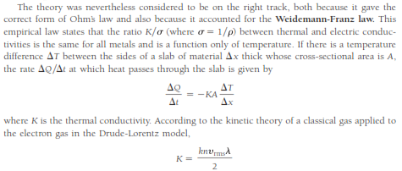
Wiedemann-Franz law

Slide 21
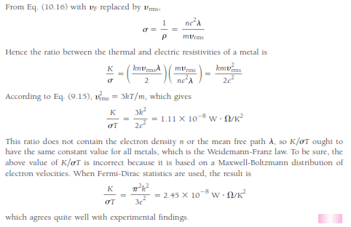
Wiedemann-Franz law

